Slide 1



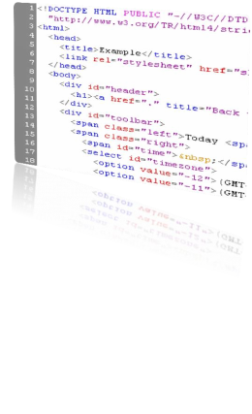







HTML Basics

Slide 2











How the Web Works?
•
WWW use classical client / server architecture
• HTTP is text-based request-response protocol
25
HTTP
Page request
HTTP
Server response
Client running a
Web Browser
Server running Web
Server Software
(IIS, Apache, etc.)

Slide 3


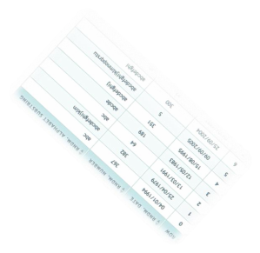


HTML Basics
Text, Images, Tables, Forms

Slide 4
What is HTML?
•
HTML is the standard markup language for creating Web
pages.
•
HTML stands for Hyper Text Markup Language
•
HTML describes the structure of Web pages using markup
•
HTML elements are the building blocks of HTML pages
•
HTML elements are represented by tags
•
Browsers do not display the HTML tags, but use them to
render the content of the page

Slide 5
A Simple HTML Document
Example
Explanation
<html>
<head>
<title>Page Title</title>
</head>
<body>
•
The <html> element is the root element
of an HTML page
•
The <head> element contains meta
information about the document
•
The <title> element specifies a title for
the document
<h1>My First Heading</h1>
<p>My first paragraph.</p>
•
The <body> element contains the visible
page content
</body>
</html>
•
The
<h1>
element
defines a large heading
•
The <p> element defines a paragraph

Slide 6
HTML Tags
•
HTML tags are element names surrounded by angle brackets:
• <tagname>content goes here...</tagname>
•
HTML tags normally come in pairs like <p> and </p>
•
The first tag in a pair is the start tag, the second tag is the end
tag
•
The end tag is written like the start tag, but with a forward
slash inserted before the tag name

Slide 7
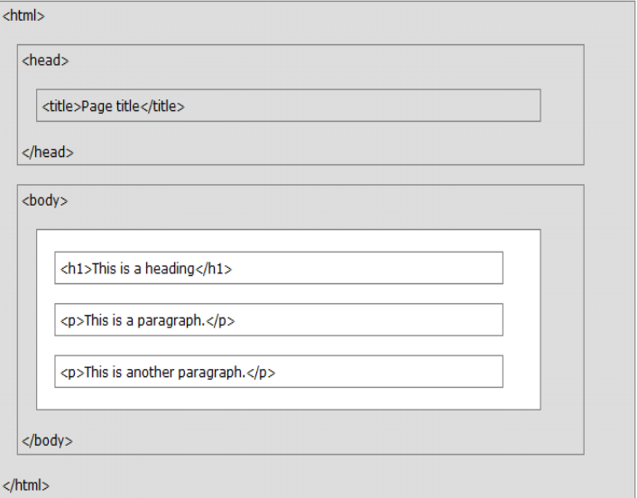
HTML Page Structure

Slide 8
HTML Versions
Version
Year
HTML
1991
HTML 2.0
1995
HTML 3.2
1997
HTML 4.01
1999
XHTML
2000
HTML5
2014

Slide 9
Creating HTML Page
Write HTML Using Notepad or TextEdit
Save the file on your computer using .html or
.htm extension and set the encoding to UTF-8
View the HTML Page in Your Browser

Slide 10


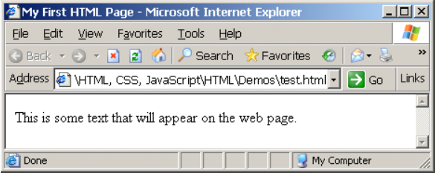
First HTML Page
test.html
<!DOCTYPE HTML>
<html>
<head>
<title>My First HTML Page</title>
</head>
<body>
<p>This is some text...</p>
</body>
</html>
33

Slide 11



First HTML Page: Tags
<!DOCTYPE HTML>
Opening tag
<html>
<head>
34
<title>My First HTML Page</title>
</head>
<body>
Closing tag
<p>This is some text...</p>
</body>
</html>
An HTML element consists of an opening tag, a closing tag and the content inside.

Slide 12

First HTML Page: Header
HTML header
<!DOCTYPE HTML>
<html>
<head>
35
<title>My First HTML Page</title>
</head>
<body>
<p>This is some text...</p>
</body>
</html>

Slide 13

First HTML Page: Body
<!DOCTYPE HTML>
<html>
<title>My First HTML Page</title>
<head>
36
</head>
<body>
<p>This is some text...</p>
</body>
</html>
HTML body

Slide 14
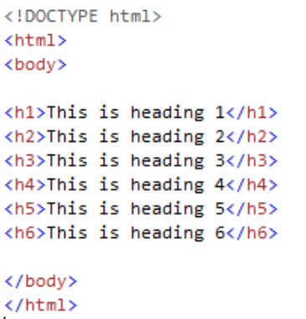
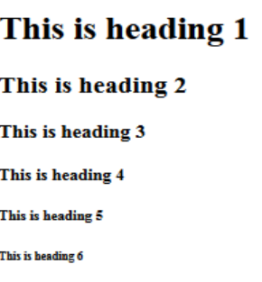
HTML Headings-
HTML headings are defined with the <h1> to <h6> tags. <h1> defines the
most important heading. <h6> defines the least important heading:
HTML Code
Output

Slide 15
Headings and Paragraphs
•
Heading Tags (h1 – h6)
<h1>Heading 1</h1>
<h2>Sub heading 2</h2>
<h3>Sub heading 3</h3>
38
• Paragraph Tags
<p>This is my first paragraph</p>
<p>This is my second paragraph</p>
• Sections: div and span
<div style="background: skyblue;">
This is a div</div>

Slide 16


Text Formatting
•
Text formatting tags modify the text between the opening tag and the
closing tag
•
Ex. <b>Hello</b> makes “Hello” bold
<b></b>
bold
<i></i>
italicized
<u></u>
underlined
<sup></sup>
Sample
superscript
<sub></sub>
Sample
subscript
<strong></strong>
strong
<em></em>
emphasized
<pre></pre>
Preformatted text
<blockquote></blockquote> Quoted text block
<del></del>
Deleted text
–
strike
through
39

Slide 17
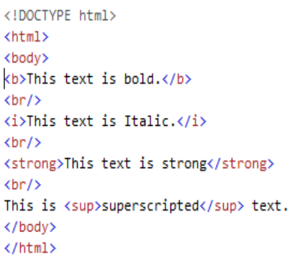
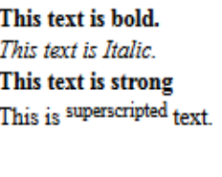
Text Formatting Example
HTML Code
Output

Slide 18


Hyperlinks: <a> Tag
•
Link to a document called form.html on the same server in the
same directory:
<a href="form.html">Fill Our Form</a>
•
Link to a document called parent.html on the same server in the
parent directory:
41
<a href="../parent.html">Parent</a>
•
Link to a document called cat.html on the same server in the
subdirectory stuff:
<a href="stuff/cat.html">Catalog</a>
• Link to an external Web site:
<a href="http://www.devbg.org" target="_blank">BASD</a>

Slide 19

Links to the Same Document – Example
links-to-same-document.html
<h1>Table of Contents</h1>
<p><a href="#section1">Introduction</a><br />
<a href="#section2">Some background</A><br />
42
<a href="#section2.1">Project History</a><br />
...the rest of the table of contents...
<!-- The document text follows here -->
<h2 id="section1">Introduction</h2>
... Section 1 follows here ...
<h2 id="section2">Some background</h2>
... Section 2 follows here ...
<h3 id="section2.1">Project History</h3>
... Section 2.1 follows here ...

Slide 20






Images: <img> tag
→ Inserting an image with <img> tag:
<img src="/img/basd-logo.png">
→ Image attributes:
src
Location of image file (relative or absolute)
alt
Substitute text for display (e.g. in text mode)
height
Number of pixels of the height
width
Number of pixels of the width
border
Size of border, 0 for no border
→ Example:
<img src="./php.png" alt="PHP Logo" />
43

Slide 21

Ordered Lists: <ol> Tag
• Create an Ordered List using <ol></ol>:
<ol type="1" >
<li>Apple</li>
<li>Orange</li>
<li>Grapefruit</li>
44
</ol>
• Attribute values for type are 1, A, a, I, or i
1.
Apple
i.
ii.
Apple
Orange
2.
3.
Orange
Grapefruit
a.
Apple
iii. Grapefruit
A. Apple
B. Orange
b.
c.
Orange
Grapefruit
I.
II.
Apple
Orange
C.
Grapefruit
III.
Grapefruit

Slide 22

Unordered Lists: <ul> Tag
• Create an Unordered List using <ul></ul>:
<ul type="disk" >
<li>Apple</li>
<li>Orange</li>
<li>Grapefruit</li>
</ul>
45
•
Attribute values for type are:
• disc, circle or square
• Apple
o Apple
▪ Apple
• Orange
o Orange
▪ Orange
• Pear
o Pear
▪ Pear

Slide 23
Definition lists: <dl> tag
•
Create definition lists using <dl>
•
Pairs of text and associated definition; text is in <dt> tag,
definition in <dd> tag
46
<dl>
<dt>HTML</dt>
<dd>A markup language …</dd>
<dt>CSS</dt>
<dd>Language used to …</dd>
</dl>
•
Renders without bullets
•
Definition is indented

Slide 24

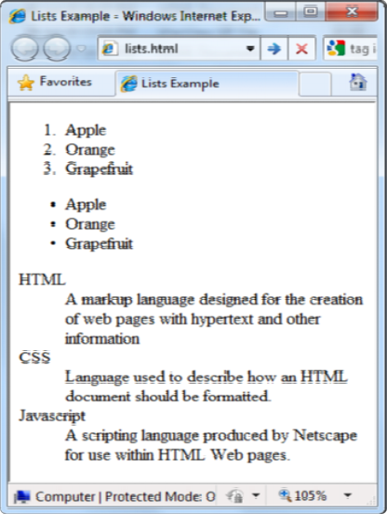
Lists – Example
lists.html
<ol type="1">
<li>Apple</li>
<li>Orange</li>
<li>Grapefruit</li>
</ol>
47
<ul type="disc">
<li>Apple</li>
<li>Orange</li>
<li>Grapefruit</li>
</ul>
<dl>
<dt>HTML</dt>
<dd>A markup lang…</dd>
</dl>

Slide 25
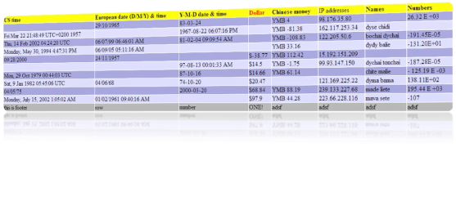
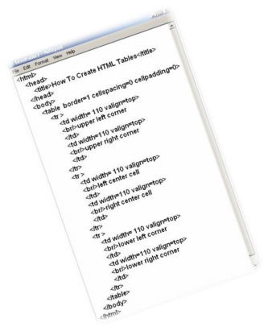
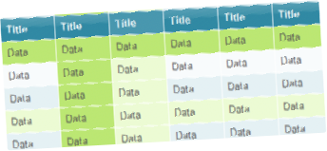
HTML Tables

Slide 26
HTML Table Tags
Tag
Description
<table>
Defines a table
<th>
Defines a header cell in a table
<tr>
Defines a row in a table
<td>
Defines a cell in a table
<caption>
Defines a table caption
<colgroup>
Specifies a group of one or more columns in a table for
formatting
<col>
Specifies column properties for each column within a
<colgroup> element
<thead>
Groups the header content in a table
<tbody>
Groups the body content in a table
<tfoot>
Groups the footer content in a table

Slide 27
HTML Tables (2)
•
Start and end of a table
<table> ... </table>
•
Start and end of a row
50
<tr> ... </tr>
• Start and end of a cell in a row
<td> ... </td>

Slide 28



Simple HTML Tables – Example
<html>
<body>
<table width=100% border = "1" bgcolor = "yellow">
<tr>
<th>Firstname</th>
<th>Lastname</th>
<th>Age</th>
</tr>
<tr>
<td>Jill</td>
<td>Smith</td>
<td>50</td>
</tr>
</table>
51
</body>
</html>

Slide 29
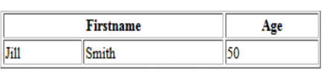
Simple HTML Tables – Example
<html>
<body>
<table width=50% border = "1" >
<tr>
<th colspan=2>Firstname</th>
<th>Age</th>
</tr>
<tr>
<td>Jill</td>
<td>Smith</td>
<td>50</td>
</tr>
</table>
52
</body>
</html>

Slide 30















Column and Row Span
•
Table cells have two important attributes:
→ colspan
→ rowspan
colspan="1"
colspan="1"
rowspan="2"
rowspan="1"
53
cell[1,1]
cell[1,2]
cell[1,2]
cell[1,1]
cell[2,1]
cell[2,1]
colspan="2"
rowspan="1"
→ Defines how
→ Defines how
many columns
many rows the
the cell occupies
cell occupies

Slide 31
HTML Tables – colspan Example
<html>
<body>
<table width=50% border = "1" >
<tr>
<th colspan=2>Firstname</th>
<th>Age</th>
</tr>
<tr>
<td>Jill</td>
<td>Smith</td>
<td>50</td>
</tr>
</table>
54
</body>
</html>

Slide 32
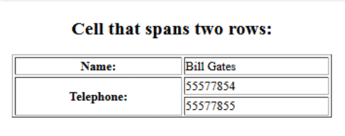
HTML Tables – rowspan Example
<h2 align=center> Cell that spans two rows: </h2>
<table style="width:50%“ border=“1” align=center>
<tr>
<th>Name:</th>
<td>Bill Gates</td>
</tr>
<tr>
<th rowspan="2">Telephone:</th>
<td>55577854</td>
</tr>
<tr>
<td>55577855</td>
</tr>
</table>
55
</body>
</html>

Slide 33
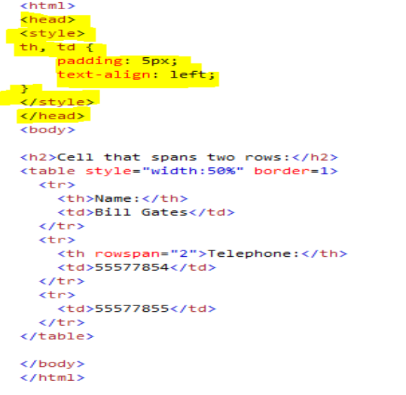
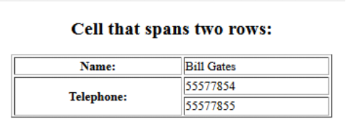
HTML Tables – rowspan
Example with <style>

Slide 34
Complete HTML Tables
•
Table rows split into three semantic sections: header, body
and footer
• <thead> denotes table header and contains <th> elements,
instead of <td> elements
57
• <tbody> denotes collection of table rows that contain the very
data
• <tfoot> denotes table footer but comes BEFORE the <tbody>
tag
• <colgroup> and <col> define columns (most often used to set
column widths)

Slide 35




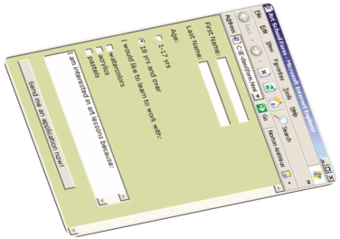
HTML Forms
Entering User Data from a Web Page

Slide 36
HTML Form
• The <form> Element
•
The HTML <form> element defines a form that is used to
collect user input:
• Syntax
<form>
form elements
</form>
•
Form elements are different types of input elements, like
•
text fields,
• checkboxes,
•
radio buttons,
•
submit buttons, and more.

Slide 37
The <input> Element
•
The <input> element is the most
•
•
HTML5 Input Types
HTML5 added several new input
types
• color
• date
• datetime-local
• email
• month
• number
• range
• search
• tel
• time
• url
• week
important form element.
•
Here are some examples:
•
Input Type Text
•
Input Type Password
•
Input Type Submit
•
Input Type Radio
•
Input Type Reset
•
Input Type Checkbox
•
Input Type Button …etc

Slide 38
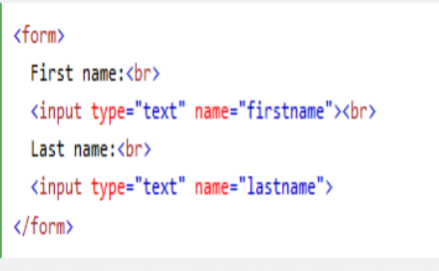
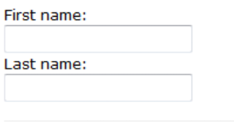
Input Type Text
• <input type="text">
•
This is how the HTML
defines a one-line text
code above will be
displayed in a browser:
input field:
• Example

Slide 39
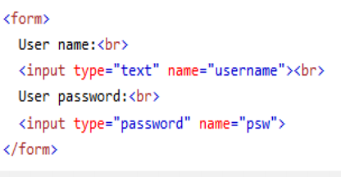
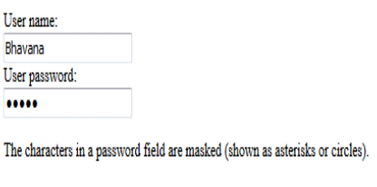
Input Type Password
• <input type="password">
• This is how the HTML
• defines a password field:
code above will be
displayed in a browser:
• Example

Slide 40

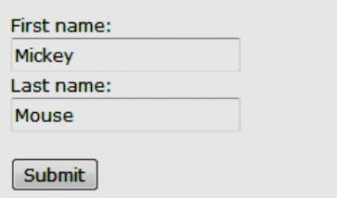
Input Type Submit
•
defines a button for submitting form data to a form-handler.
• The form-handler is specified in the form's action attribute:
• Example
<form action="/action_page.php">
First name:<br>
<input type="text" name="firstname" value="Mickey"> <br>
Last name:<br>
<input type="text" name="lastname" value="Mouse"><br><br>
<input type="submit" value="Submit">
</form>

Slide 41
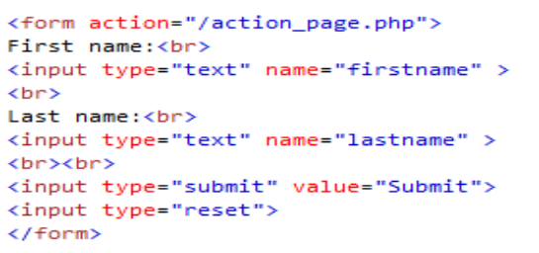
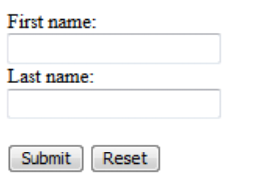
Input Type Reset
• <input type="reset"> defines a reset button that will reset all
form values to their default values:
•
click the "Reset" button, the form-data will be reset.
• Example

Slide 42

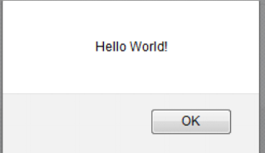
Input Type Button
• <input type="button"> defines a button:
• Example
• <input type="button" onclick="alert('Hello World!')"
value="Click Me!">
•
After clicking above button it shows output as below:

Slide 43
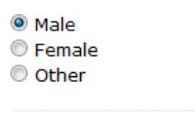
Input Type Radio
•
<input type="radio"> defines a radio button.
•
Radio buttons let a user select ONLY ONE of a limited number of
choices:
• <form>
<input type="radio" name="gender" value="male" checked> Male<br>
<input type="radio" name="gender" value="female"> Female<br>
<input type="radio" name="gender" value="other"> Other
</form>
• This is how the HTML code above will be displayed in a browser:

Slide 44
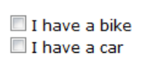
Input Type Checkbox
• <input type="checkbox"> defines a checkbox.
•
Checkboxes let a user select ZERO or MORE options of a limited
number of choices.
• Example
<form>
<input type="checkbox" name="vehicle1" value="Bike"> I have a bike
<br>
<input type="checkbox" name="vehicle2" value="Car"> I have a car
</form>
•
This is how the HTML code above will be displayed in a browser:

Slide 45
HTML Input Attributes
• The value Attribute
•
The readonly Attribute
• The disabled Attribute
• The size Attribute
•
The maxlength Attribute

Slide 46



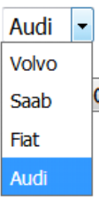
The <select> Element
(Dropdown menus)
•
The <select> element defines a drop-down list:
• <select name="cars">
<option value="volvo">Volvo</option>
<option value="saab">Saab</option>
<option value="fiat">Fiat</option>
<option value="audi">Audi</option>
</select>

Slide 47

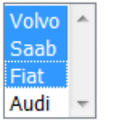
The <select> Element with
multiple selection
• <select name="cars" size="4" multiple>
<option value="volvo">Volvo</option>
<option value="saab">Saab</option>
<option value="fiat">Fiat</option>
<option value="audi">Audi</option>
</select>

Slide 48
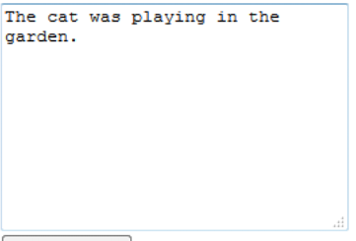
The <textarea> Element
• <textarea name="message" rows="10" cols="30">
The cat was playing in the garden.
</textarea>
•
The rows attribute specifies the visible number of lines in a
text area.
•
The cols attribute specifies the visible width of a text area.

Slide 49


HTML Forms – Example
form.html
<form method="post" action="apply-now.php">
<input name="subject" type="hidden" value="Class" />
<fieldset><legend>Academic information</legend>
<label for="degree">Degree</label>
<select name="degree" id="degree">
<option value="BA">Bachelor of Art</option>
72
<option value="BS">Bachelor of Science</option>
<option value="MBA" selected="selected">Master of
Business Administration</option>
</select>
<br />
<label for="studentid">Student ID</label>
<input type="password" name="studentid" />
</fieldset>
<fieldset><legend>Personal Details</legend>
<label for="fname">First Name</label>
<input type="text" name="fname" id="fname" />
<br />
<label for="lname">Last Name</label>
<input type="text" name="lname" id="lname" />

Slide 50

HTML Forms – Example (2)
form.html (continued)
<br />
Gender:
<input name="gender" type="radio" id="gm" value="m" />
<label for="gm">Male</label>
<input name="gender" type="radio" id="gf" value="f" />
<label for="gf">Female</label>
<br />
<label for="email">Email</label>
<input type="text" name="email" id="email" />
</fieldset>
<p>
<textarea name="terms" cols="30" rows="4"
readonly="readonly">TERMS AND CONDITIONS...</textarea>
</p>
<p>
<input type="submit" name="submit" value="Send Form" />
<input type="reset" value="Clear Form" />
</p>
</form>
73

Slide 51
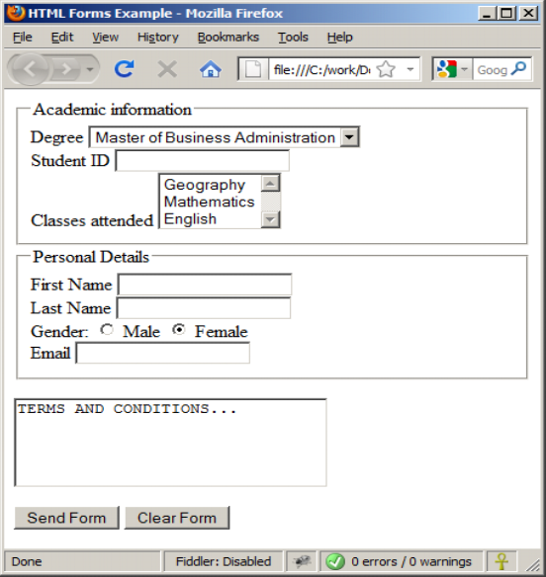
HTML Forms – Example (3)
form.html (continued)
74

Slide 52
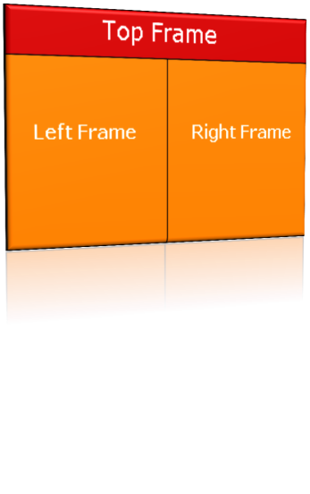
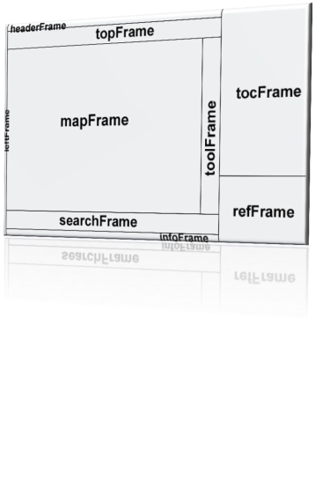
HTML Frames
<frameset>, <frame> and <iframe>

Slide 53
HTML Frames
•
Frames provide a way to show multiple HTML documents in a
single Web page
•
The page can be split into separate views (frames) horizontally
and vertically
76
•
Frames were popular in the early ages of HTML development,
but now their usage is rejected
•
Frames are not supported by all user agents (browsers, search
engines, etc.)
• A <noframes> element is used to provide content for non-
compatible agents.

Slide 54
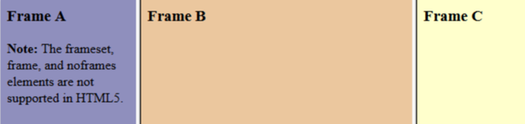
HTML <frame> Tag.
• Example
• A simple three-framed page:
• <frameset cols="25%,50%,25%">
<frame src="frame_a.htm">
<frame src="frame_b.htm">
<frame src="frame_c.htm">
</frameset>
•
Each <frame> in a <frameset> can have different attributes, such as
border, scrolling, the ability to resize, etc.

Slide 55
Html
Html5
Doctype declaration in Html is too longer
<!DOCTYPE HTML PUBLIC "-//W3C//DTD HTML
4.01//EN" "http://www.w3.org /TR /html4
/strict.dtd">
DOCTYPE declaration in Html5 is very
simple "<!DOCTYPE html>
character encoding in Html is also longer
<!DOCTYPE HTML PUBLIC "-//W3C//DTD HTML
character encoding (charset) declaration is
4.0 Transitional//EN">
also very simple <meta charset="UTF-8">
Audio and Video are not part of HTML4
Audio and Videos are integral part of
HTML5 e.g. <audio> and <video> tags.
Vector Graphics is possible with the help of
technologies such as VML, Silverlight, Flash etc
Vector graphics is integral part of HTML5
e.g. SVG and canvas
It is almost impossible to get true GeoLocation of
user browsing any website especially if it comes
to mobile devices.
JS GeoLocation API in HTML5 helps identify
location of user browsing any website
(provided user allows it)
Html5 use cookies.
It provides local storage in place of cookies.
Not possible to draw shapes like circle, rectangle,
triangle.
Using Html5 you can draw shapes like
circle, rectangle, triangle.
Does not allow JavaScript to run in browser. JS
Allows JavaScript to run in background. This
is possible due to JS Web worker API in
HTML5
runs in same thread as browser interface.
Works with all old browsers
Supported by all new browser.

